Slide 1
Deutsche Telekom Laboratories
Anger Recognition Demonstrator
Dr. Felix Burkhardt

Slide 2
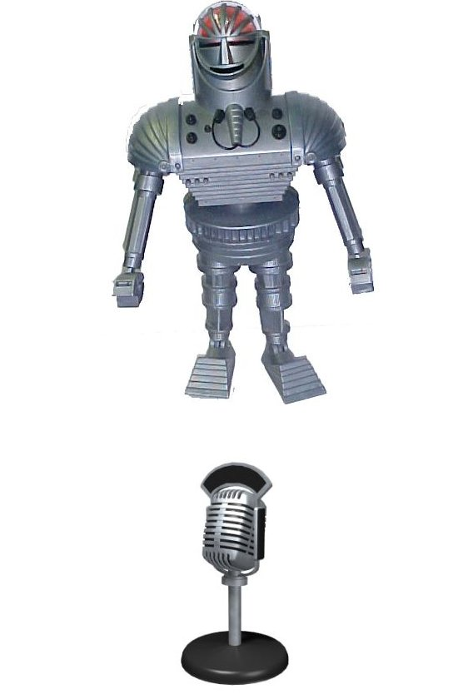
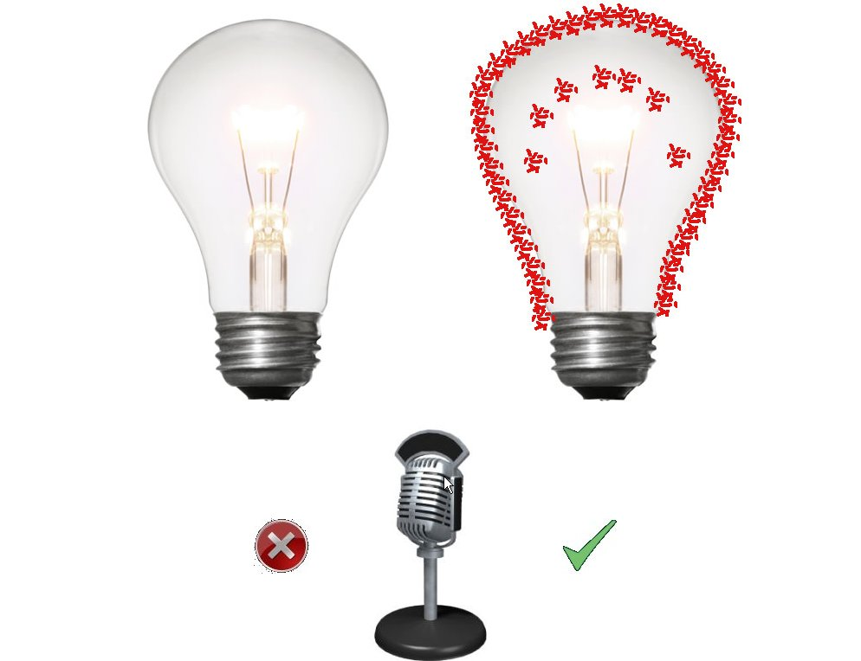
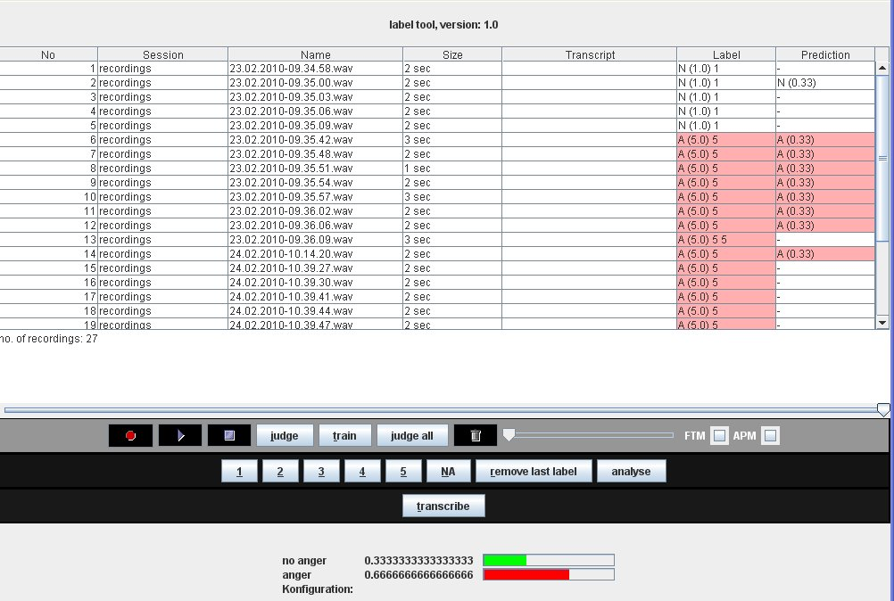
A demonstration scenario for the recognition of angry speech in human-machine interaction.
Simple interface (Fig 1): click on microphone, robot talks to you and recognizes anger from sound of voice.
Alternative interface presents light bulb anger indicator with self-learning feedback option (Fig 2).
Can be trained to fit demonstrator‘s way to express anger (Fig 3).
Demonstrator runs without network under Windows or Linux directly from USB-stick.
Extendable to recognize e.g. joyful, sad enthusiastic, stressed or drunken speech.
Fig 2: alternative interface
Fig 1: demonstration interface
Fig 3: training interface

